Slide 1
Play-by-play Stat Extraction Logic

Slide 2
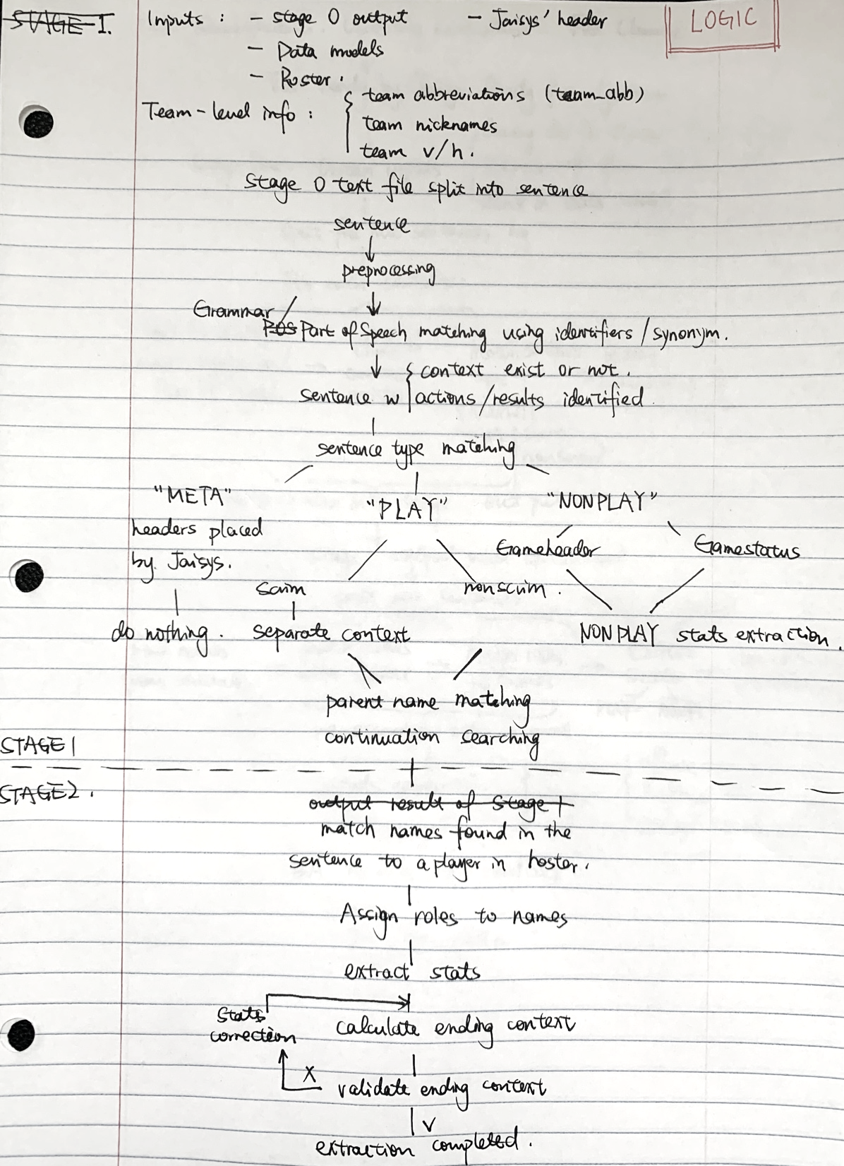
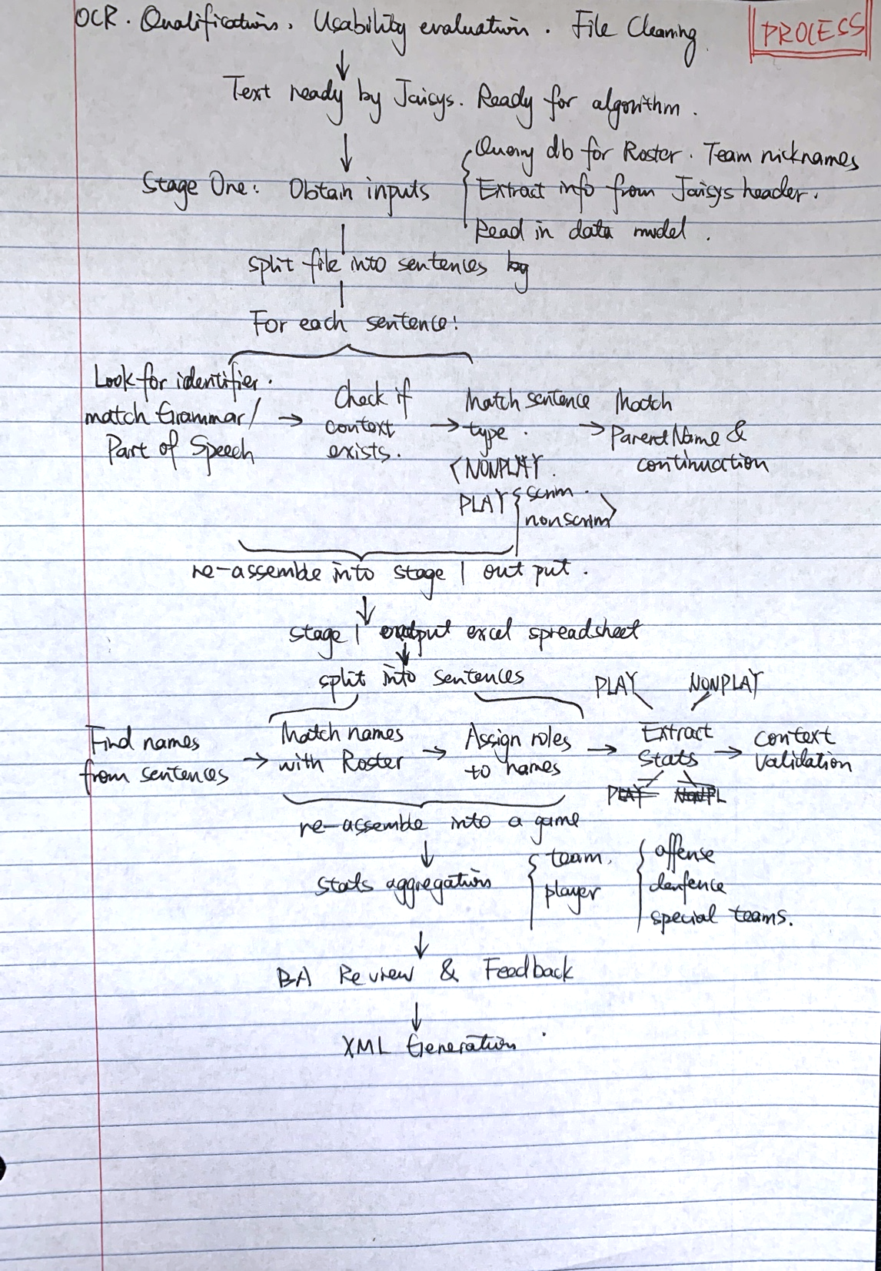

Slide 3
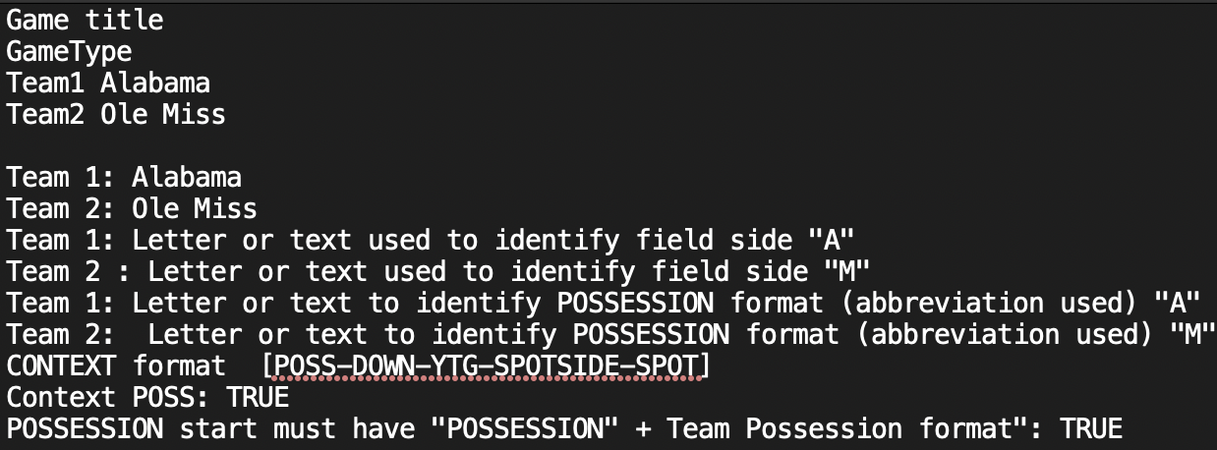
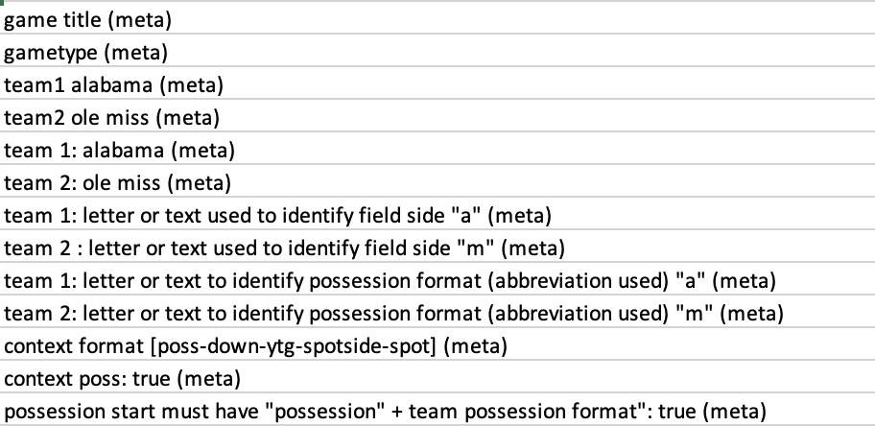
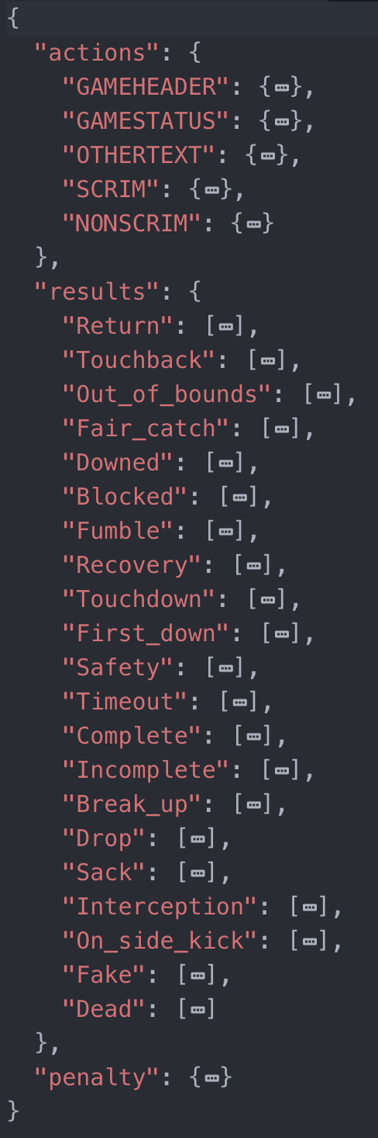
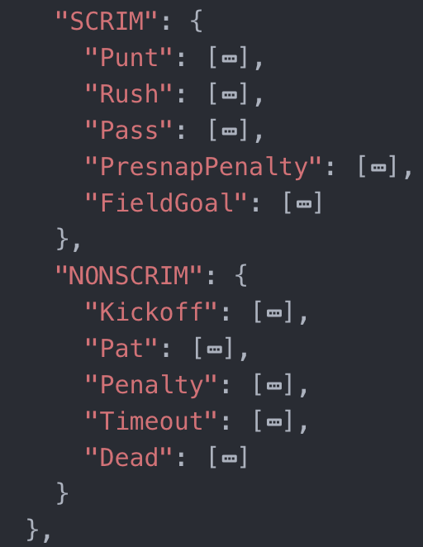
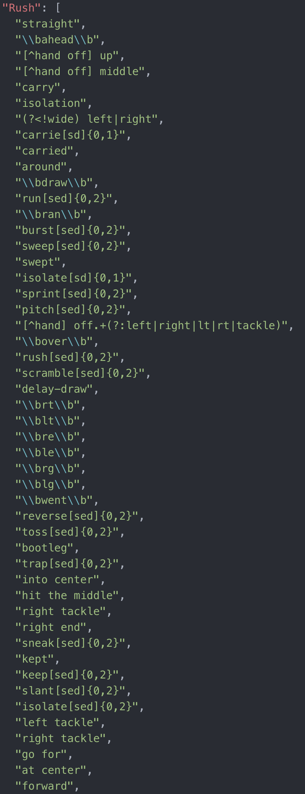
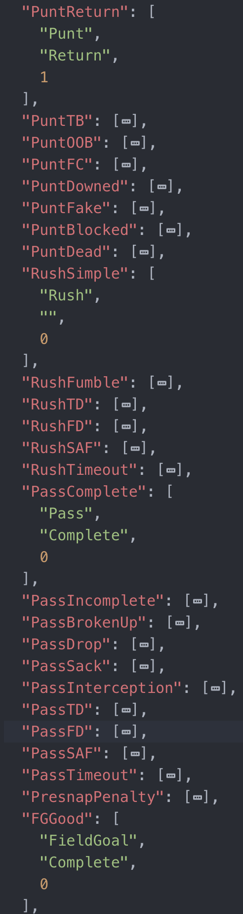
Stage 1
Get inputs
Stage 0 output: Jaisys cleaned text file.
Read in the text file.
Remove lines that have zero numbers or zero letters.
Find Jaisys headers and mark them with “(meta)”.
Roster:
Querry db for 9 seasons (4 years before, the current year, 4 years later). [name, last name, position, jersey number, class, uuid]
Data Models:
Action/result – sentence type – regex patterns (a.k.a sentence patten model)
Action result pairs – parent names (a.k.a matching tuple)

Slide 4
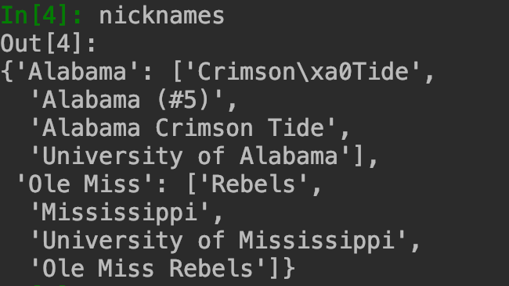
Stage 1
Team-level info
Team abbreviations – come from Jaisys Header
Team nicknames – come from db
Team v/h – specified when starting the algorithm
Break into lines
Break into lines. Each line is a sentence.
Preprocessing
Symbol clean up: replace tab, “-”, “--”, “_”,multiple spaces by single space.
Fix common typos letter l or number 1: “1t”, “1g”, “1e”, “lst”
Convert all ordinal numbers to cardinal number. E.g. 3rd, third, three all replaced by “3”.
Replace all nicknames with standard name used as input when starting the algorithm. E.g. ‘Clemson tide’, ‘university of alabama’, replaced by just ‘alabama’. (Remark: in this game ‘bama’ is also used somewhere, but wasn’t replaced because the nickname collection doesn’t have it in the db.
Put everything into lower case

Slide 5
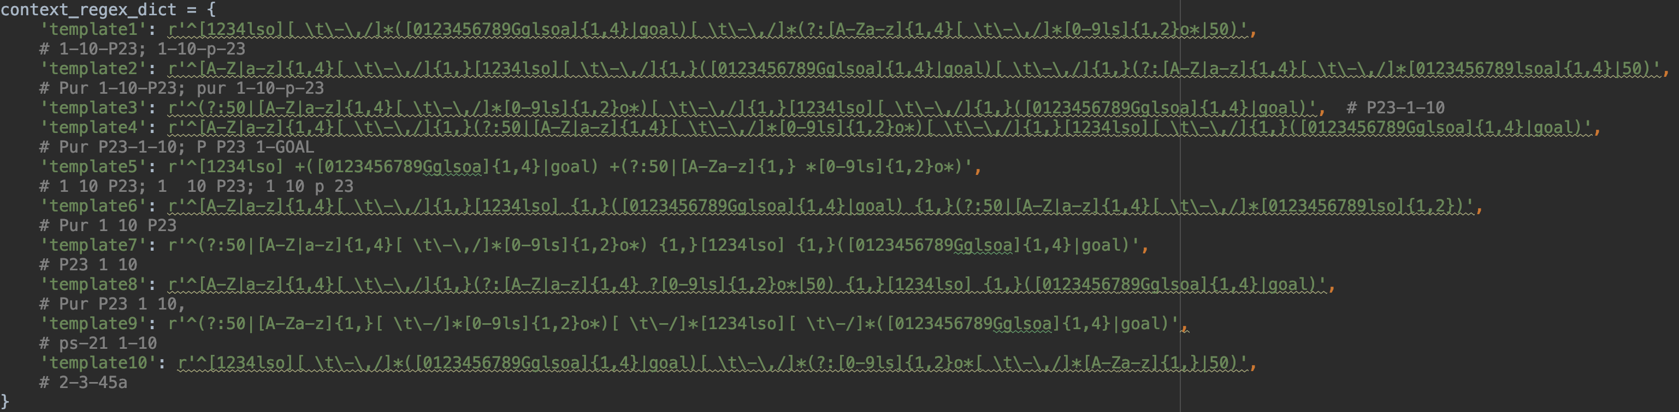
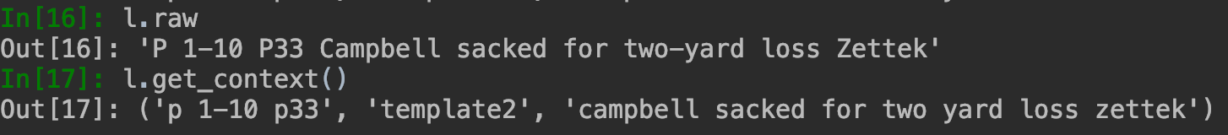
Stage 1
Grammar/Part of Speech matching
Search for context.
get_context() function
For each type of action/result, consider a match for this type if any of its pattern is found. Match for actions first, and then match for results.
ptn_matcher() function
E.g.
Frank handed to Kim missed loss 6 yards. → action: Pass; result: Incomplete
Frank left fast past lt gain 7. → action: Rush; result: (none)
Frank rushed wide to the right and loss 3 yards. → action: Rush; result: Incomplete
Frank attemped a field goal but was wide to the left. → action: FG, Rush; result: Incomplete

Slide 6
Stage 1
Sentence type matching
get_sentence_type() function
General rule: if the actions belonging to a sentence type can be matched in the sentence, map the sentence to this sentence type.
Other conditions:
If the sentence is marked with “(meta)” it is a Jaisys header. Its sentence type is directly coded as META.
If the sentence has context, then must be a scrim
If the sentence has no context , then NEVER a scrim
Handle multiple matches. If actions of more than 1 sentence type can be found:
SCRIM and NONSCRIM is always prior to others
Naughty Kick: Kick can be used in
Punt, FG (SCRIM)
pat, and kickoff (NONSCRIM)
By default, kick is an identifier for kickoff.
If the sentence has context, then it is a scrim. Replace the ‘kick’ with ‘punt’. (this won’t introduce error in parent name*)
After steps:
SCRIM: split the sentence into context and text. Match for parent name later
NONSCRIM: do nothing for now. Match for parent name later
GAMEHEADER/GAMESTATUS: Nonplay stat extraction (Not yet)
META: Jaisys headers. Do nothing.
Notes:
* Because punt and fg won’t have same overlapping results. Kick is not an identifier for FG.

Slide 7
Stage 1
EXAMPLE 1:
m 3-7 a7 Manning pass completes to Reed at a1 and goes in for touchdown at 12:30, 21 yards in 5 plays. Poole pat is good.
pass (8) complete (12)
touchdown (53)
Candidates:
PassComplete, Distance = 4, starting position = 8
PassTD, Distance = 45 starting position = 8
Conclusion: Major parent name: PassComplete. Don’t expect continuation. (FN)
For SCRIM and NONSCRIM: parent name and continuation matching
get_parentname() function
Find all actions / results under the sentence type along with their positions.
Cross-pair all actions with all results. If a pair can be found in the matching tuples, then select the respective parent name as a candidate.
Rank the candidates by
The distance between action and result
The starting position of the action
Take the top parent name as major parent name
If the parent name allows continuation (the 3rd item in the match tuple = 1):
Continuation text = the text after the result of the major parent
Look for actions/results in the continuation text
Continuations are not paired for whole parent names
Hard rules.
If actions has only Punt and result is ‘dead’ or nothing, then major parent = PuntDowned
If results has td and others, then td takes priority.
If a FG has touchback as result, then FGBad
If actions has only rush, and no rush-related results are found, then RushSimple.
EXAMPLE 2:
m 4-2 m47 northren punts into end zone, no return. 1:02 remaining.
punt Touchback
Return
Candidates:
PuntTB
PuntReturn
Conclusion: PuntTB
EXAMPLE 3:
A 1-10 A31 Hayden pass intercepted by Naely on 30, returned to 45..
pass interception
Return
Candidates:
PassInterception
(Pass and Return is not an acceptable pair)
Conclusion: PassInterception. Allow continuation. So continuation = return.

Slide 8
Stage 1
Supplementary functions to help parent name matching
deduct_action_from_name() function
If no other action can be found in the sentence, find player names in the sentence. If see <name> … to/intend for <name> pattern, then it is a pass.
E.g. A 1-10 A20 Hayden completes to Husso, T by VanDevender, loss of one.
E.g. A 1-10 A20 Hayden completes to Dorna, carries to M21, gains 59 yards and FIRST (FN)
Deduct_pass_result() function
If a Passing play doesn’t have any explicit result catchable (complete/incomplete/etc), use the next context to test whether the pass was a gain or a loss. If gain, then complete. If loss, then incomplete. (FP)
Output all lines into excel worksheet.
(END OF STAGE 1 )

Slide 9
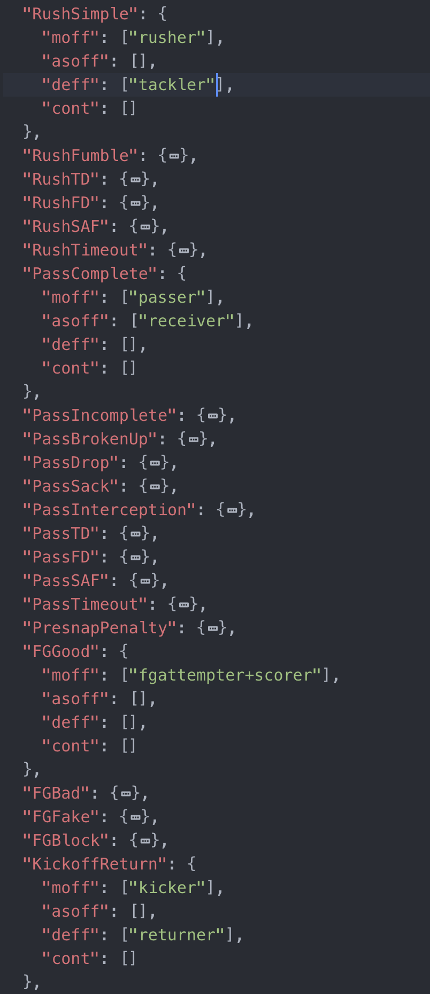
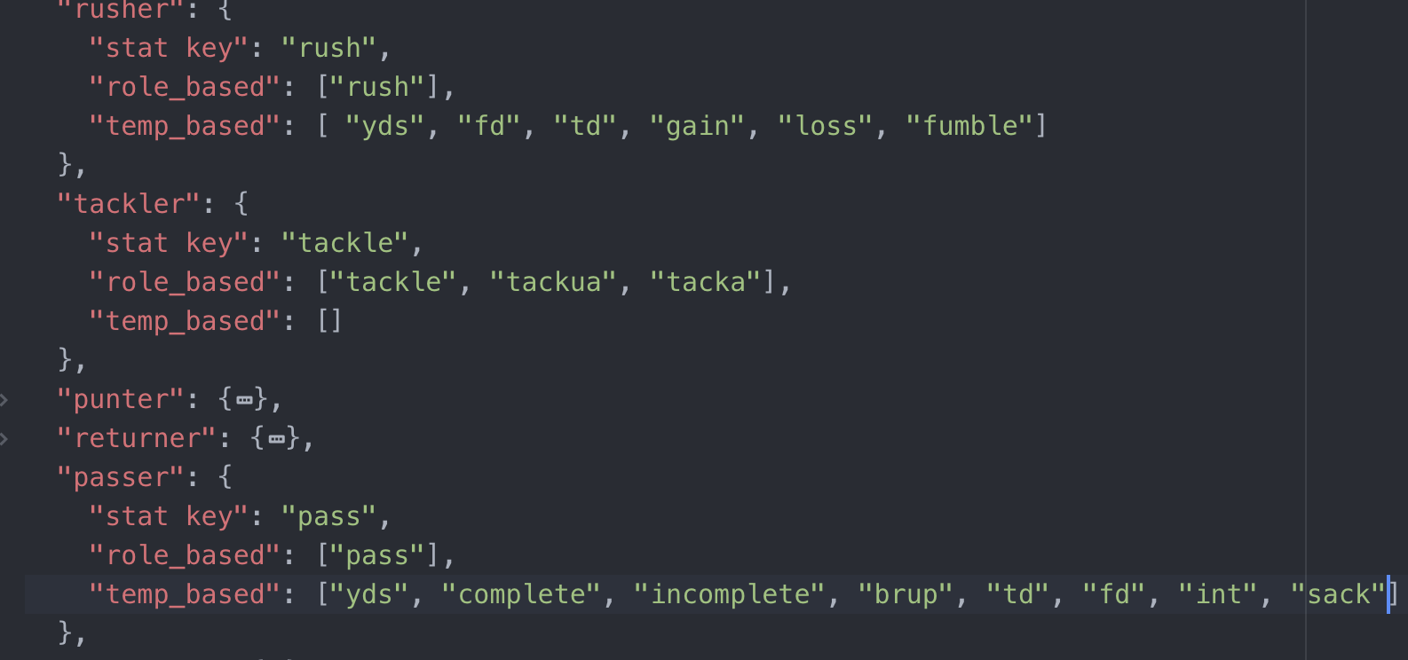
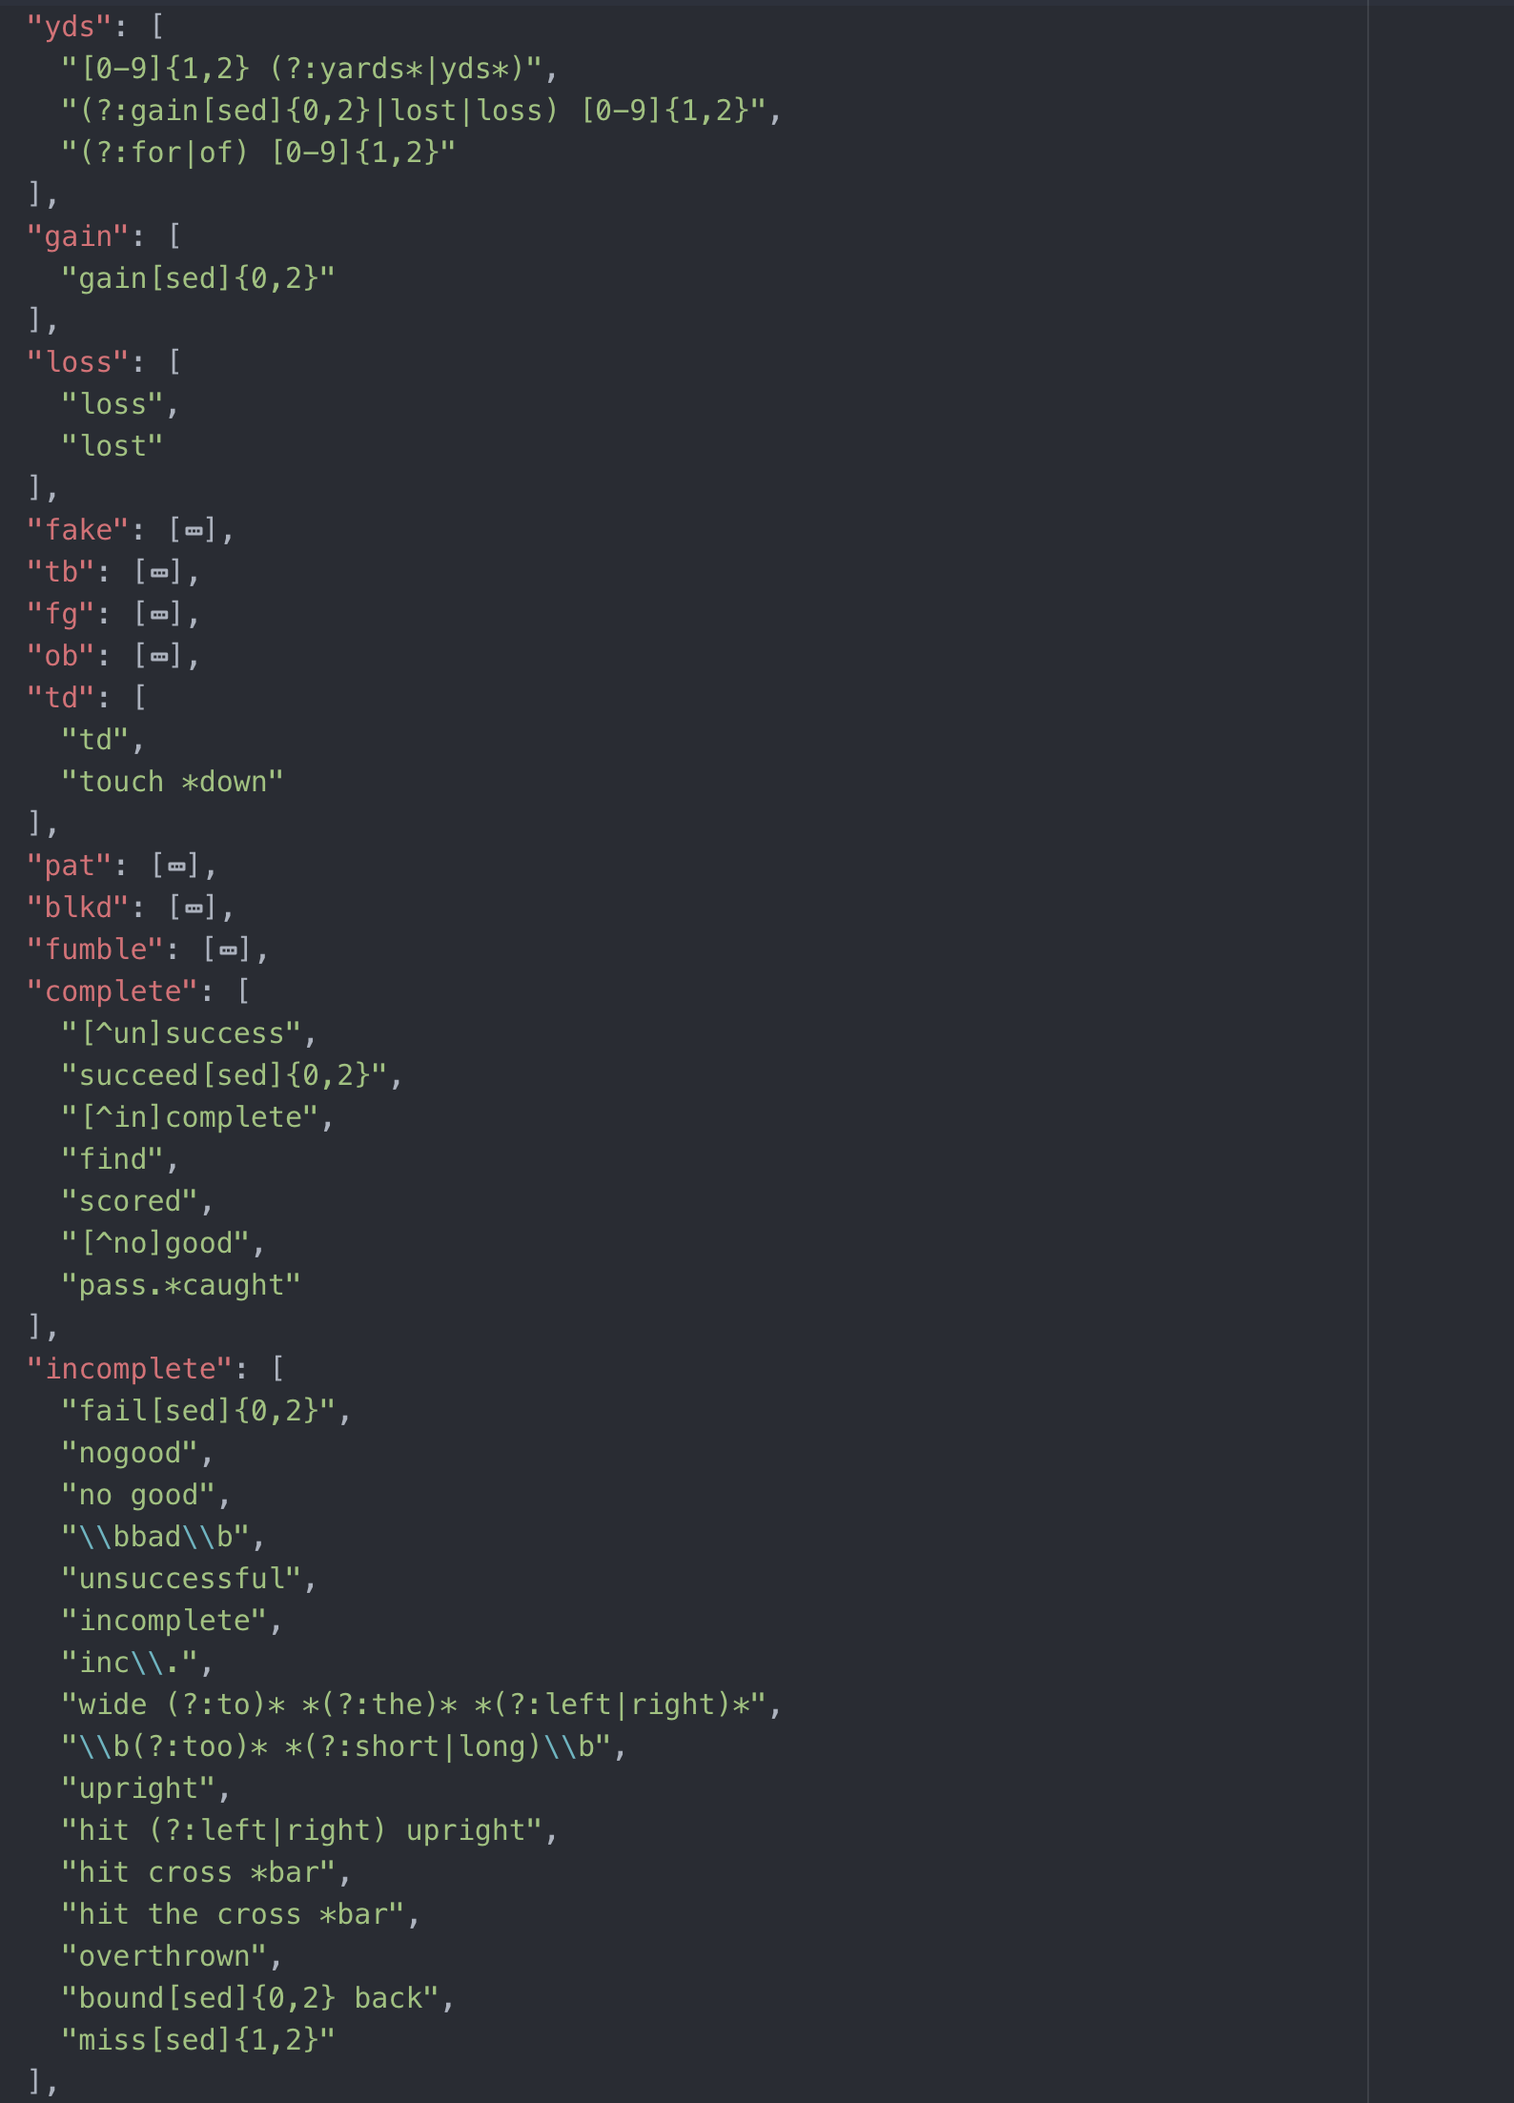
Stage 2
Get inputs
Stage 1 output: Excel sheet
Pre-processed raw sentence
Unprocessed raw sentence
Beginning context
Sentence type
Parent name
Continuation actions/results if any
Roster:
Querry db for 9 seasons (4 years before, the current year, 4 years later). [name, last name, position, jersey number, class, uuid]
Data Models:
Parent name – role
Role – stats
Stats – patterns

Slide 10
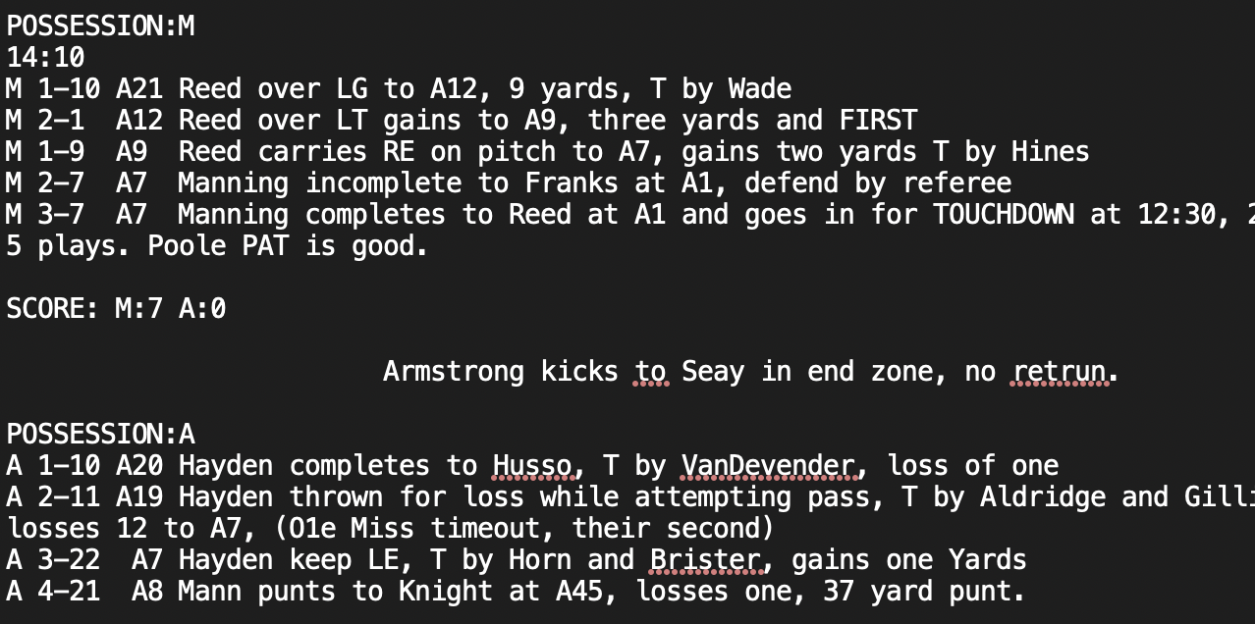
Stage 2
For SCRIM and NONSCRIM:
Track possession of the ball:
update_poss() function:
Possession based on beginning context
Possession based on change of drives.
Search for player names in the sentence
Find_names_from_raw() function:
Split the text (after context is removed) into words
Exclude any stop words.
Assume: name format is consistent in the same game. Last names are used by default.
A word is considered a name if any of these three conditions is true:
100% perfect match with a last name in the roster
(Recall everything is in lowercase after preprocessing in stage 1). The word in the unprocessed raw is in title format.
If non of the two above is true, and if the word has a over 85% match with a last name from the roster.
Tag the words considered as names.
EXAMPLE:
Preprocessed raw: m 2-6 m24 manning throws long for studdard, incomplete
Unprocessed raw: M 2-6 M24 Manning throws long for Studdard, incomplete
manning throws long for studdard, incomplete → [‘manning’, ‘studdard’]
Condition 1:
{'manning': [[('MANNING', 100, 39), ('MANNING', 100, 40)], 'Manning'],
'studdard': [[('STUDDARD', 100, 56), ('STUDDARD', 100, 57)], 'Studdard’]}
Condition 2:
M 2-6 M24 Manning throws long for Studdard, incomplete
Output: named_line
'<name manning> throws long for <name studdard>, incomplete'

Slide 11
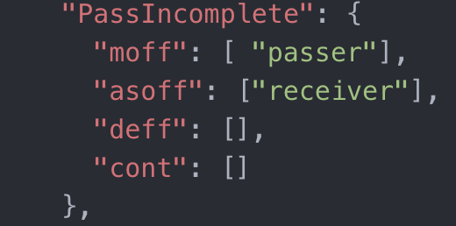
Stage 2
For SCRIM and NONSCRIM:
EXAMPLE:
Beginning context: m 2-6 m24. → Possessing team: m
Named_line: '<name manning> throws long for <name studdard>, incomplete’
Parent name: pass incomplete
Expected roles:
Assign the roles:
'<name manning, passer> throws long for <name studdard, receiver>, incomplete’
Assign the team:
'<name manning, passer, m> throws long for <name studdard, receiver, m>, incomplete’
Player matching:
’manning’ from Ole Miss → MANNING,A
‘studdard’ from Ole Miss → STUDDARD,V
Output:
'<name MANNING,A; passer; m> throws long for <name STUDDARD,V; receiver; m>, incomplete’
EXAMPLE FP:
m 1-10 m35 reed over middle for no gain t by rowell
→ '<name REED,RANDY; rusher; m> <name LOVE; tackler; a>r middle for no gain t by <name rowell; N/A>'
Assign roles to each name in the sentence
Assign_roles_to_named_line() function:
Assign roles:
Based on parent name, some roles are expected as major offender, assist offender, defender
Assume the roles in a sentence always follows the order of 1)major offender 2) assist offender 3) defender
Tag the found names with the roles in order
Assign team
Assign the possessing team for major/assist offender
Assign the non-possessing team for defender
If more names than roles, some names can’t be assigned name, so put N/A.
Player matching
Given player name and team, match the name to an actual player in the roster. Change the name with the matched standardized name.
Output: roled_line

Slide 12
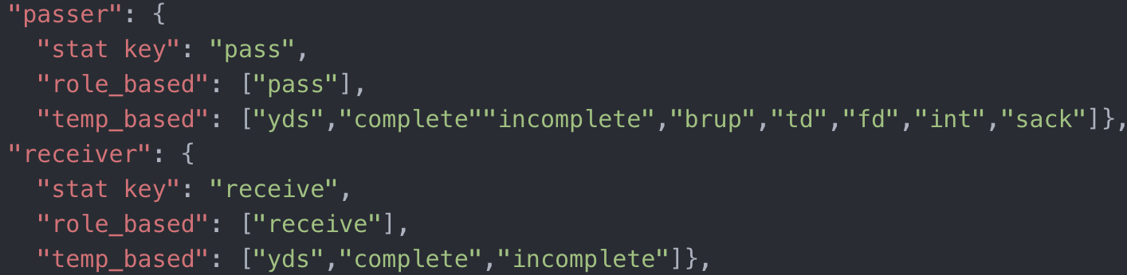
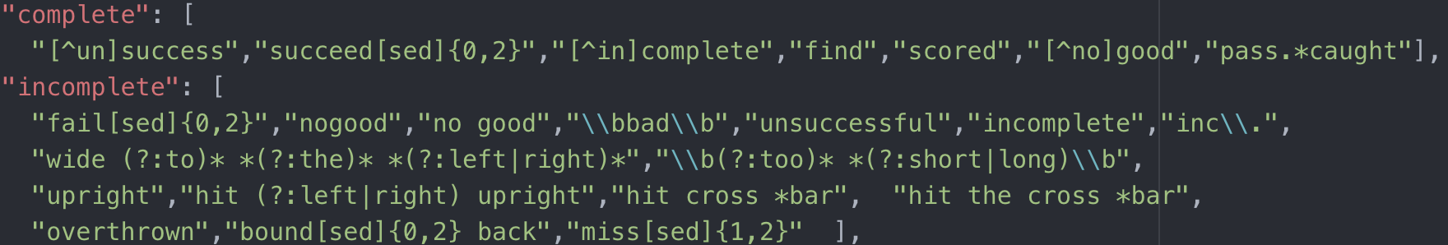
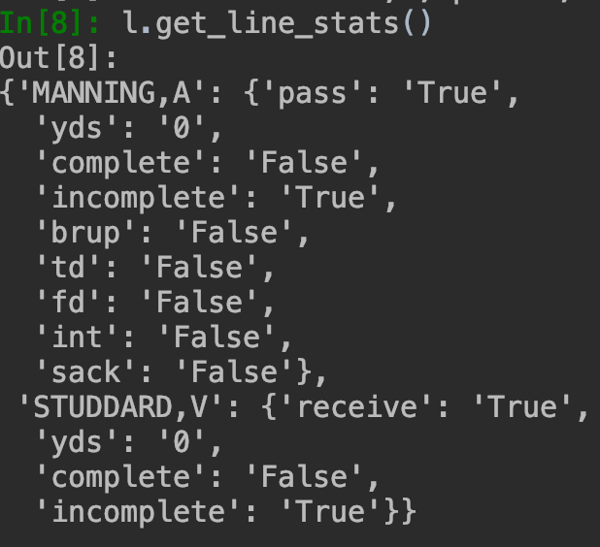
Stage 2
For SCRIM and NONSCRIM:
EXAMPLE:
Beginning context: m 2-6 m24. → Possessing team: m
Roled_line: '<name MANNING,A; passer; m> throws long for <name STUDDARD,V; receiver; m>, incomplete’
Parent name: pass incomplete
Players: Expected stats:
<name MANNING,A; passer; m>
<name STUDDARD,V; receiver; m>
Stats and templates:
Output
Extract stats for each name with roles assigned
get_line_stats() function:
Find the player names tagged with role
For each player with his role:
All role-based stats = True
Template stats:
Yds: there may be more than 1 ydg in the sentence. search for all templates and choose the closest one to the player’s name
Pts: if has scorer role, pts is related to parent name. (td=6, fg=3, patkick=1, patrush=2, etc)
others: True is template can be found.
Derived stats:
Punt related: inside20, inside10, over50
Fumblelost, fumble recovery by team/opp: depends on which team takes next play’s poss
Fd: (not yet implemented) if gain > ytg
Output: backend stats (I use for trouble shoorting)
modify_stats_for_punt_and_kickoff() function:
Special treatment for punt and kickoff
Start spot, punt/kick yds, return yds, end spot.
Know any 3 → 😃; otherwise insufficient information
If no yards in sentence in a rush simple / pass complete, to be fixed by context validation
Could be both false. (Gain and loss in Rush plays). To be fixed by context validation

Slide 13
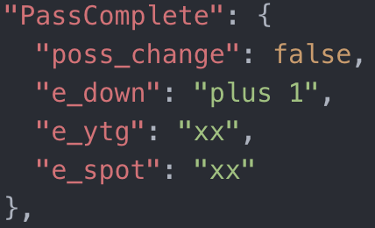
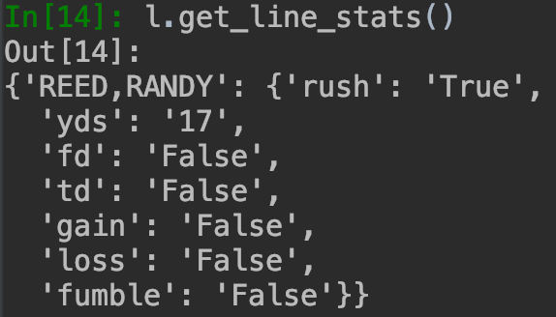
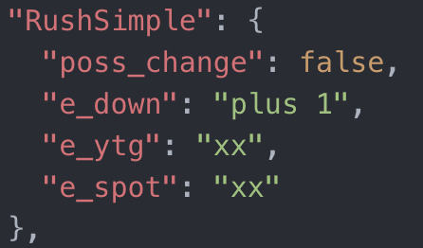
Stage 2
For SCRIM and NONSCRIM:
EXAMPLE:
Beginning context: m 2-6 m24
Roled_line: '<name MANNING,A; passer; m> throws long for <name STUDDARD,V; receiver; m>, incomplete’
Parent name: pass incomplete
Backend stats: Parent name-context validation model
Yards change = 0
Output: calculated ending context: m 3-6 m24
Calculate ending context use the extracted stats
calculate_ending_context() function
Context has: poss, down, ytg, side, spot
To calculate ending context, need
beginning context, yards change in the play (positive/negative for gain/loss), and rules related to parent name from data model.
Ending poss:
Data model: switch if true
4 th down gain still < ytg, then switch
Ending down:
Data model
If play gain < ytg, then down+1. Otherwise down = 1
Ending ytg:
Data model
Beginning ytg – yards change. If yards change > beginning ytg, ending ytg = 10
Ending side and ending spot:
Beginning spot + yards change
If ending spot is explicit in the sentece, use it.
Tricky stuff: ytg = ‘ g’; spot = ‘50’ with side = ‘’
EXAMPLE:
Beginning context: m 3-7 m32
Roled_line: '<name REED,RANDY; rusher; m> carries rg on draw to m9, 17 yards and 1'
Parent name: RushSimple
Backend stats: Parent name-context validation model
Yards change = 0 (because gain loss both false)
Output: calculated ending context: 'm 4-7 m 9’
→ Will need context validation
Typo. Should be m49.

Slide 14
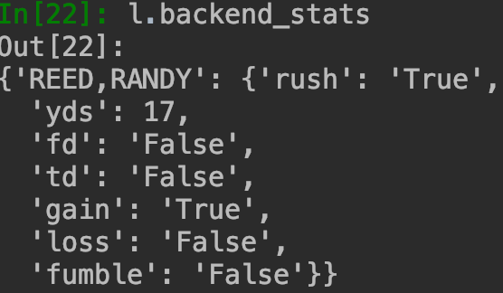
Stage 2
For SCRIM and NONSCRIM:
EXAMPLE:
Beginning context: m 2-6 m24
Roled_line: '<name MANNING,A; passer; m> throws long for <name STUDDARD,V; receiver; m>, incomplete’
Parent name: PassIncomplete
Backend stats: Calculated ending context: m 3-6 m24
Next scrim play:
m 3-6 m24 pass manning completes to franks, for 1 and gain of 11
Conclusion: correct stat extraction
Context Validation
get_supv_ending_context() function
Look for the next scrim with valid beginning context. Use that context as the supervising ending context for the current play.
Context_validation() function
Unvalidatable cases and alerts:
Structure error in beginning/supv ending context
→ alert: “context structure error”
The sentence has penalties:
→ alert: “check for penalties”
The difference in ball spot <=1 yard:
→ alert: “difference is only 1 yd, maybe tolerable”
If the calculated ending context is different from supv_ending_context: use supv_ending_context – beginning context of the play → supv yard change, gain/loss, complete/incomplete
Search for the supv yard change number in the sentence
If found: modify backend stats using the validation results
If not: refuse validation results to avoid introducing new FP
Re-do calculate_ending_context() function using modified stats and validate again with supv_ending_context
Pass: → alert: “reverse validation successful”
Fail: → alert: “still have problem”
EXAMPLE:
Beginning context: m 3-7 m32
Roled_line: '<name REED,RANDY; rusher; m> carries rg on draw to m9, 17 yards and 1'
Parent name: RushSimple
Backend stats: Calculated ending context: m 4-7 m 9
Next scrim play:
m 1-10 m49 manning throws to franks incomplete, overthrown
Conclusion: need reverse validation
Reverse validation:
Supv yard change = M49 – M32 = 17 yards, gain
”17” exist in the sentence? → True
So correct the stats:
Re-calculate ending context: m 1-10 m49. Pass.
Reverse validation successful

Slide 15
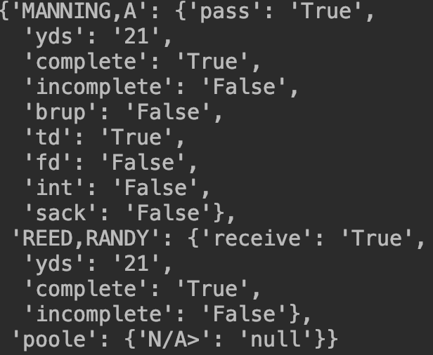
Stage 2
Score Validation
EXAMPLES
m 3-1 al manning sneaks over lg and goes in for touchdown, 7 plays 47 yards, 7:29, poole pat is good, mckellar holds.
a 3-10 m15 hayden completes to cashing end 1 for touchdown at 2:20, 87 yards in 13 plays, hayden hit for 1oss by leblanc and horn as attempt for 2 points fails.
o 4 8 p18 o'morrow's field goal was from 35 yards at 0:48 (powe1l held) 12 yards, 7 plays, 3:52 elapsed
PAT is often in the same sentence with TD → PAT often not extracted
PassTD sometimes has ‘complete’ identifier → ParentName is PassComplete → TD no extracted
FG: result is often omitted if FG is good.
Solution:
Track score: update_score() function:
Both team are zero at game start. Score tracker’s Initial state.
If stats extraction shows ‘pts’ from the sentence, the tracker add those points to the possession team.
Obtain supervision: get_score_supervision() function
If the sentence is a ‘Score’ sentence, the stated score is extracted as supervision.
If supv score = score tracker, pass validation.
If supv score != score tracker, deduct_missing_score() and put the deduction as alert. Let the tracker remember the gap in scores.
Guess what is missing: deduct_missing_score() function
{'1': 'patkick', '2': ['patpass', 'patrush', 'saf'], '3': 'FG', '6': 'TD’, ‘7’: ‘TD + PATKick’, ‘8’: ‘TD + 2-pts cvsn,’ '9': 'FG + TD’}
Put an alert at the score supervision line:
“<team whose score is missing>: <deduction>”
EXAMPLE
Game start: Tracker: A:0, M:0
When game came to play #30: ParentName: PassComplete
Poss Team: M
Backend stats:
No pts were extracted from this sentence
Tracker: A:0, M:0
Score validation: → Disagree. Gap = 7 pts
Tracker: A:0, M:0
remember gap of 7 pts to avoid double count when seeing the next missing score
Deduct missing score: Gap = 7 → TD+PATKick missing for M
m 3-7 a7 pass manning completes to reed at a1 and goes in for touchdown at 12:30, 21 yards in 5 plays. poole pat is good.
score: m:7 a:0

Slide 16
Stage 2
Re-format backend-stats to the output stat format
organize_stats() function
Read in the empty table, fill the contents of backend stats into the empty table.
Put rush yards to gain/loss directly
Get derived stats related to Punt and FD (not yet completed)
Aggregate, XML validation, output to BA review template
Stage 3
After BA’s review and modifications, generate XML and put into database.
(not yet started)

Slide 17
Questions:
Open issues for Stage 2
BA Driven feedback process
Algorithm improvement
BA preference for production running.

